Slide 1
Modelling of student success: two universities – two different yet the same stories
Jakub Kuzilek
jakub.kuzilek@hu-berlin.de
Humboldt University
2020-06-30

Slide 2

Short story

Slide 4
Project history
RETAIN (2011 – 2012)
Microsoft Research Cambridge short project (2012 – 2013)
OU Analyse (2013 - )
2014 summer – 2 courses
2014 winter – 11 courses
2015 – 2017 scaling up
2018 - all courses at the university

Slide 5
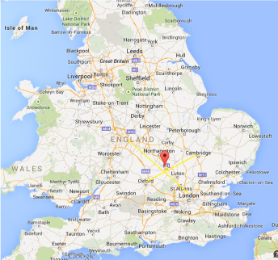

About the Open University

Slide 6
About the Open University
The largest distance learning institution in UK
Over 180,000 students
One course takes approx. 10 months
Each course counts usually 30-60 ECTS credits
Completely online (using Moodle - highly modified version)
Only PhD students are at the campus
Students are older than regular university students
One needs no previous education to study at the OU
Drop-out in many Level 1 courses around 40%

Slide 7
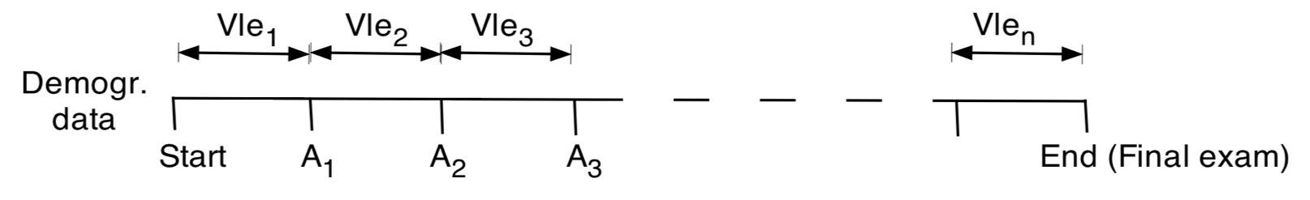
Problem
With available data:
Demographic data
Assessments
VLE activities
Identify students at risk of failing the module as soon as possible so that the intervention is meaningful and cost effective.

Slide 8
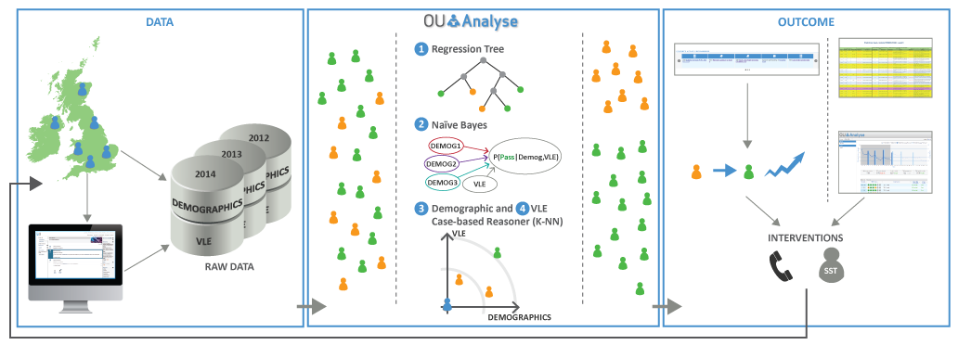
How to support at-risk students?
Predictive modeling

Slide 9
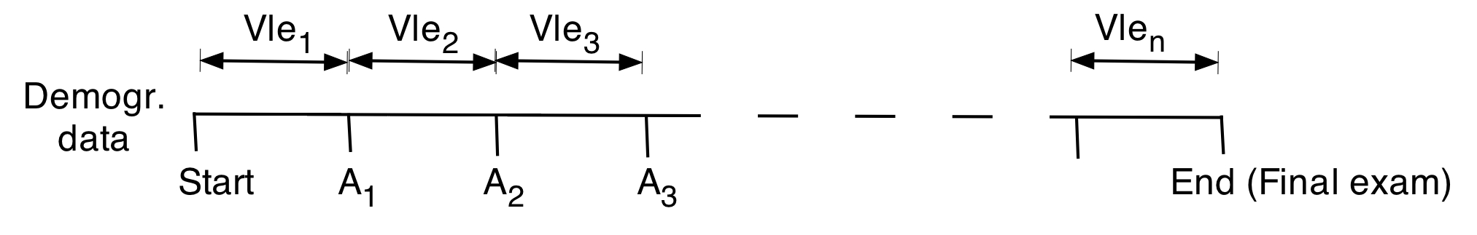
Predictive modeling
History we know
Future we can estimate
We are here

Slide 10
What is the best time for at-risk student identification?
Students, who fail first Tutor Marked Assignment (TMA) in fourth week has high probability of course failure (>95%)
We need to start predicting before first TMA

Slide 11
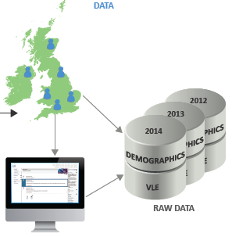
Data
Demographic data
age, gender, new/cont. student, education, IMD, postcode, occupation, motivation
Study related data
Pay dates, registration data, estimated workload, number of previous attempts
Assessments
Scores, submission dates, assessment weights, cut-off dates, late submissions
VLE activities
VLE like system, log data, number of clicks per day per site, activity types

Slide 12
VLE activities are important
Demographic data
New student
Male
No formal qualification
Sex
N/C
TMA1
Education
Without VLE:
Probability of failing at TMA1 = 18.5%
Sex
With VLE:
N/C
Clicks | Probability | Nr of students
0 | 64% | 4
1-20 | 44% | 3
21-100 | 26% | 5
101-800 | 6.3% | 14
TMA1
Education
VLE

Slide 13
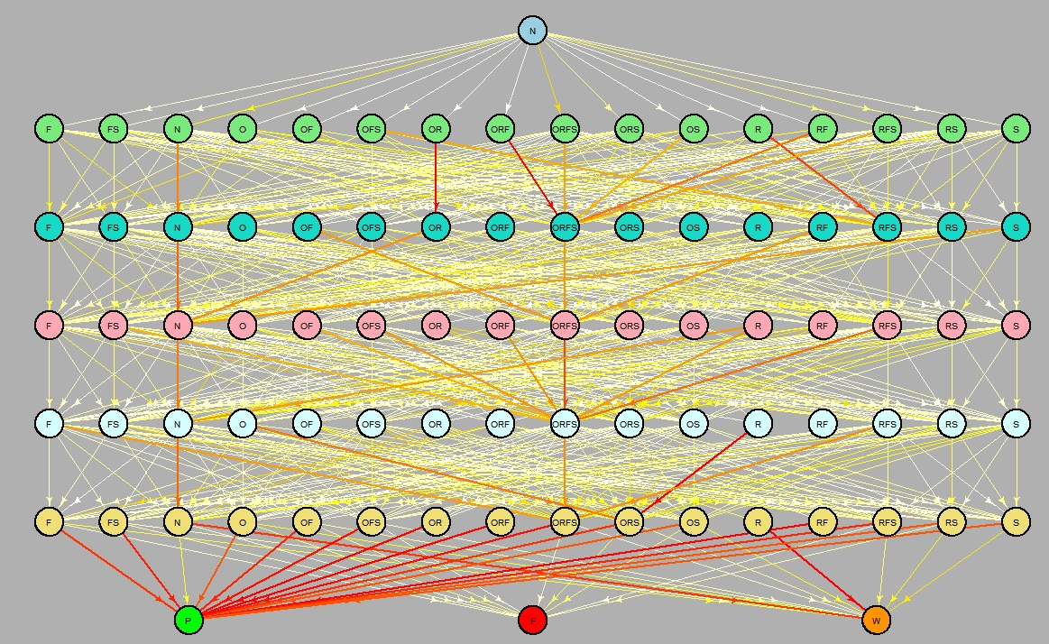
Module “fingerprints”
Identification of important VLE activities using historical data
Course specific
time

Slide 14
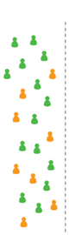
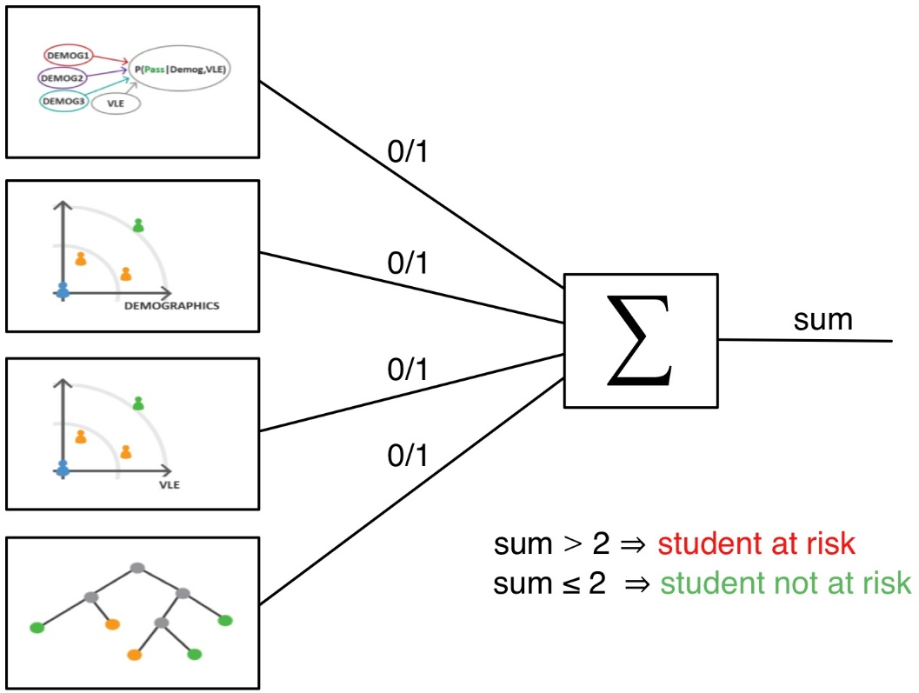

Predictive models

Slide 15
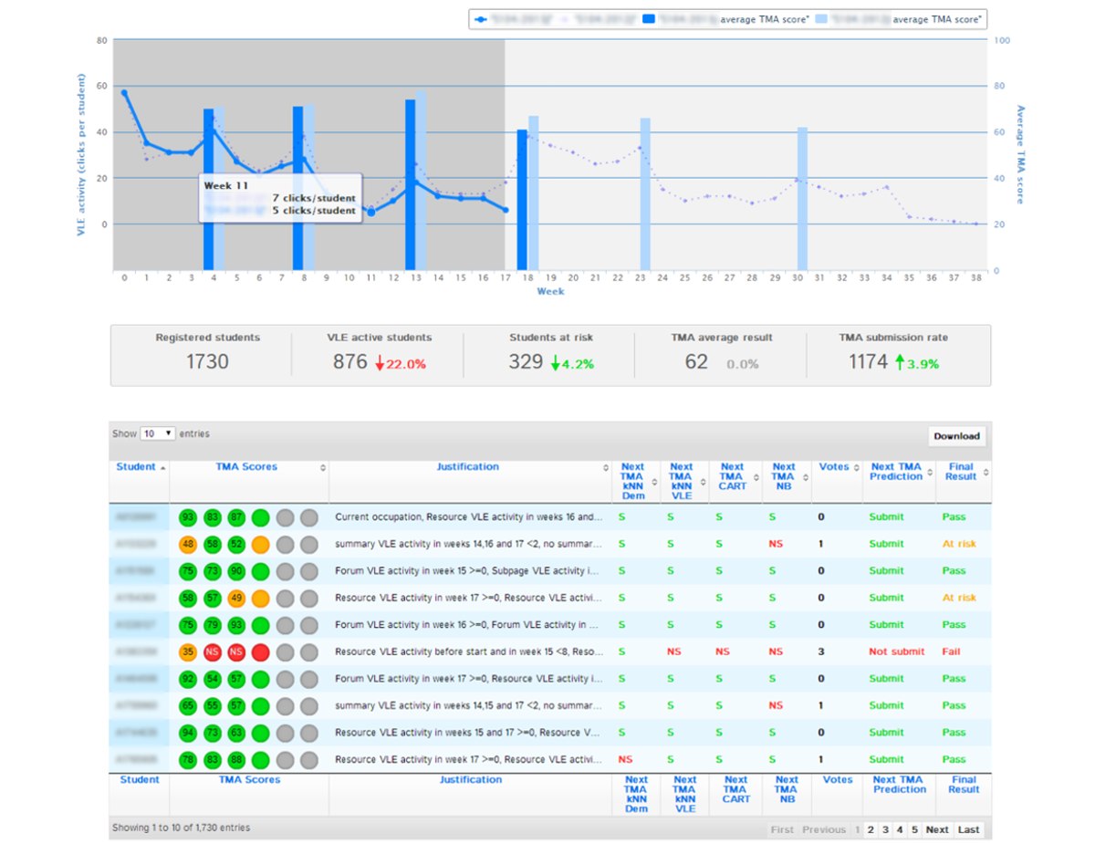

Prediction of at-risk students
TUTOR
AT RISK

Slide 16
Demo

Slide 18
History
2016 cooperation with FME started
“Spin-off” of OU Analyse
2018 foundation of LA team at CTU

Slide 19
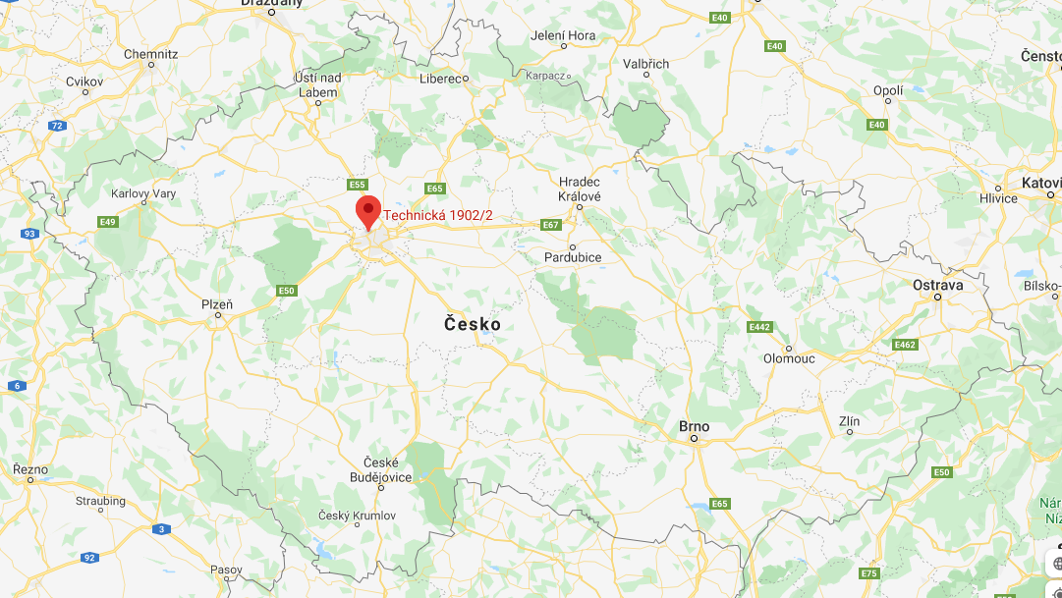
About FME, CTU in Prague

Slide 20
About FME, CTU in Prague
one of the oldest and largest CTU faculties
3000 students in bachelor and master programmes
approx. 1/3 are first year students
Retention in the first academic year is around 50 %

Slide 21
Problem
Given:
Registration data
Exam data
Identify first year students who are at risk of failing as soon as possible so that the intervention is meaningful.

Slide 22
How to identify at-risk students?
Apply OU Analyse approach.
But we have much smaller data (less information) and collection of data happens only at start of the academic year and during exam periods.

Slide 23
Data
Registration data:
Study programme de-/registration date, study year, age, gender, high school
Exam data:
Type of exam, exam date, exam result (A-F or pass/fail), ECTS credits, examiner
Progression rules for cont. studies
> 15 credits in WS
> 30 credits in whole academic year

Slide 24
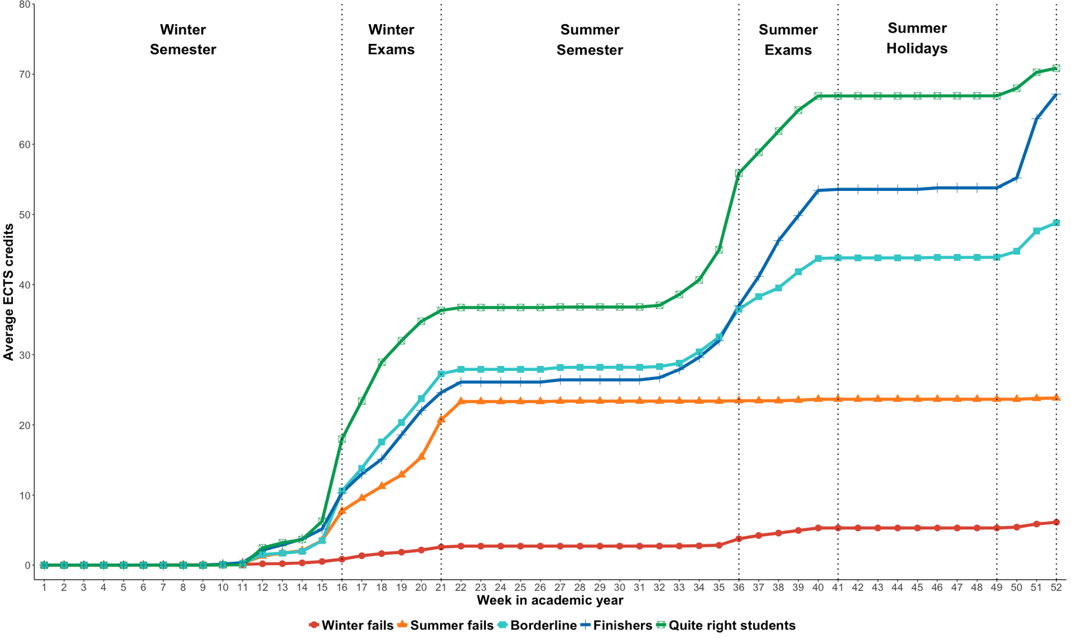
Analysis
Progression graph
Divide students into multiple groups
Plot Average of achieved credits vs. week in academi year

Slide 25
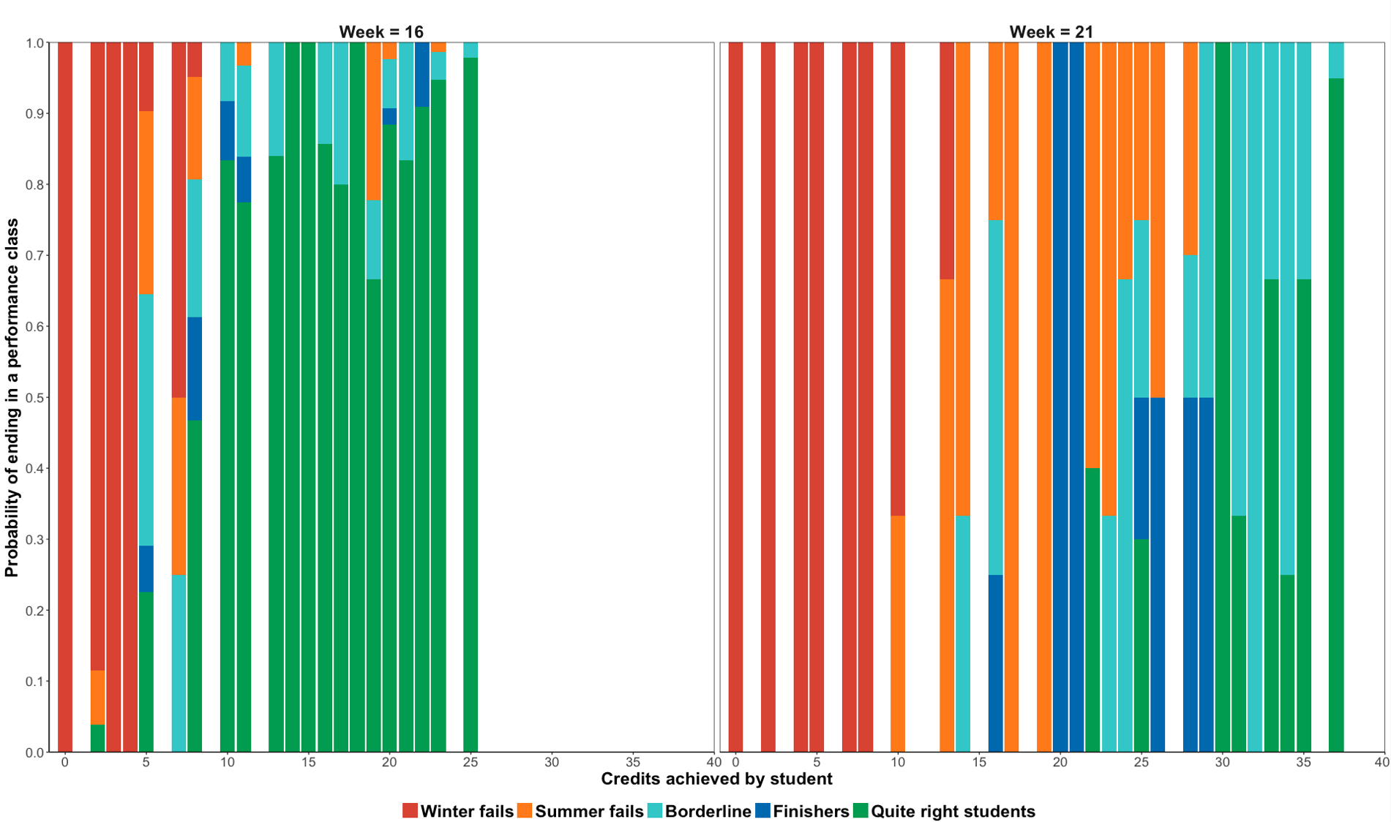
Analysis
Study probabilities
Compute posterior probability of being in one of our five groups based on achieved credits
Plot the probability vs. credits vs. week

Slide 26
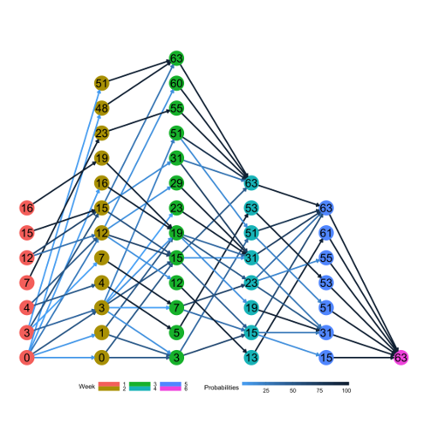
Exam behaviour
Markov chain representation of exam “behaviour” of successful students
Identification of best strategies for passing the WS exams

Slide 27
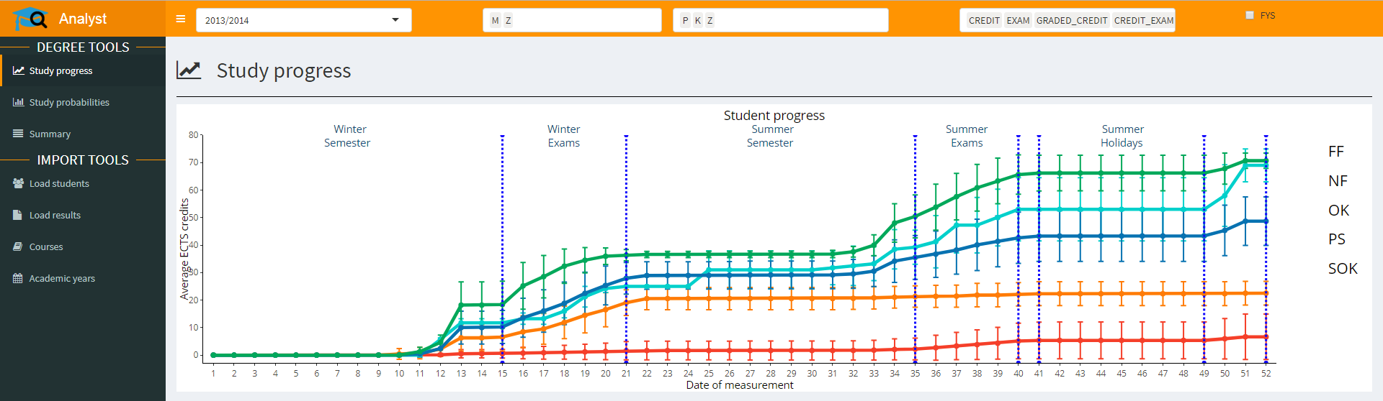
Dashboard

Slide 28
Lessons learned
Historical data provides important evidence for current students
Importance of the most recent data (& continuous update of them)
Data privacy & security
Stakeholders (students, teachers, management) have different needs
Cooperation between researchers/”data miners” and teachers is critical
Pilot testing
Predictive modelling without intervention carried out by teachers has no impact on learning

Slide 29
Thank you!

